Slide 1
Plot:
Xiaohu is a movie producer who is looking out for a solution to maximize his profits from movies after release. Previously, he has released many movies, but he claims that he is not getting the returns that he is expecting. He is not able to understand the cause and that makes him anxious and desperate for a solution.
Disclaimer: Not based on a True Story

Slide 2
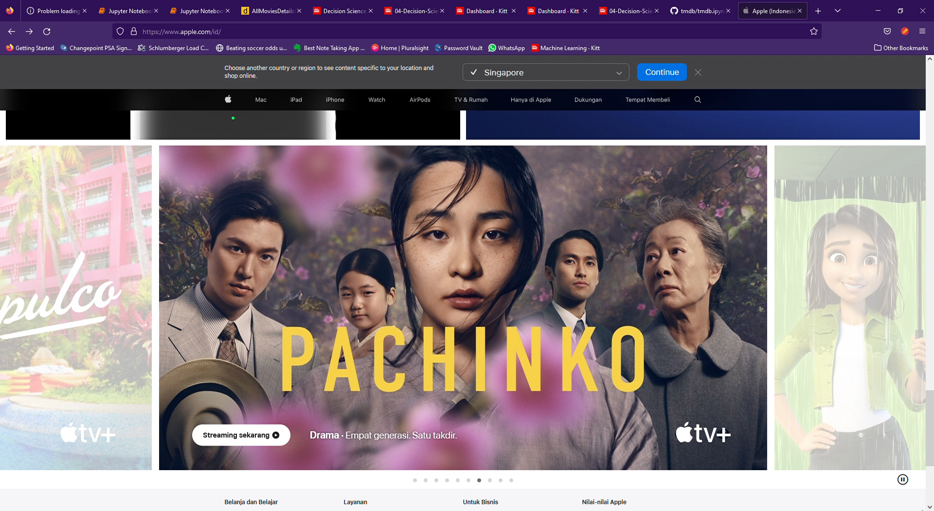
Movie Revenue Prediction
A project by: Team Outliers
Notes:
Hello Sahu! How are things going. I hear from Kent about your problem, and I think we got something that might be useful to you.
Allow me just 5 minutes of your time, and you will realize how easy it is for you to make decisions based on our application, Alchemy. Sounds good?
Perfect! But before everything let me just relax you by facts!

Slide 3
$60 M
500
50%
Source: motion picture association
Notes:
As you know already, more than 500 movies are released every year in US alone each on an average costing around 60M dollars. And do you know how many of them are successful? 50% (shau). Exactly!

Slide 4
Need
Customer Segment
Product
Our product will cater to director’s and producers to estimate and optimize for the best revenue possible.
Alchemy is a tool for movie makers to estimate the amount of revenue their movie is expected to generate based on their genres, budget, runtime, advertisement etc…
50%
Notes:
That's why we as team are focusing on reducing this gap by using our expertise in Data Science. Our Application Alchemy, enables Directors and producers, like you, to estimate the revenue of the movie even before it's release and, allows you to tweak few relevant parameter to therby increasing the chances of success of a movie and thereby maximise your returns on Investments. Amazing isn't it? So how does this actually work?

Slide 5


Supervised (Regression) ML Workflow
Input X: Features derived from data
Predicts y: Continuous Output
Historical
Movie metadata
Trained Model
Movie Revenue
(Algorithm + learned parameters)
Learn y = f(X) Relationship
Notes:
Well behind the scene what Alchemy is doing is nothing fancy!
We are preforming a Supervised Regression Machine Learning where we are letting the computer learn from a huge collection of historical movie data and a provided algorithm that adapts based on examples of intended behavior to predict the revenue. The resulting program, consisting of the algorithm and associated learned parameters, is called a trained model.

Slide 6
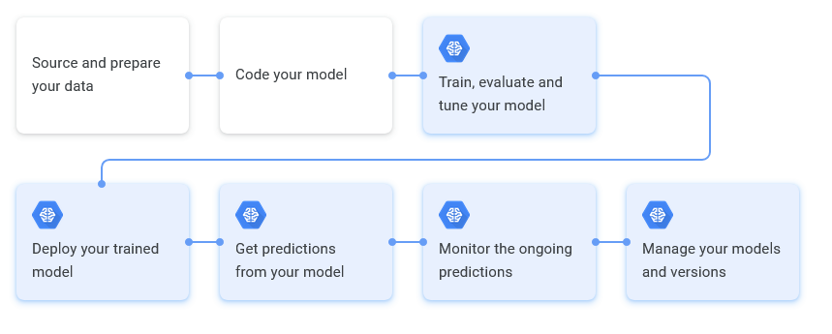
Well Defined workflow
Update data
Try new features
Try new models
Update parameters
Get predictions from model
Monitor ongoing predictions
Manage the model and versions
Notes:
Well that’s a good question and I will answer it in twofolds:
First we have a system inplace
We are constantly trying out new model and training them on updated data that we gather by various methods.

Slide 7
Dataset Feature Distribution
WEB SCRAPING
22%
Belongs to Collection, Vote Count, Number of screens, Start Rating,
Missing revenue and budget information. (5k)
8000 Movie data
20 different Genres
Time period: Since 190
58%
TRAINING DATASET
Budget, Genres, Imdb_id, title, Production Companies, Runtime,
Status, Tagline
FEATURE ENGINEERING
28%
Inflation adjusted Budget, Star Rating for actors, Release Age,
Notes:
We recently trained our models with a batch size of almost 8000 new movies from various genres and time periods.
Close to 58% of our information such as Budget, Genres, Runtime are coming form the raw dataset.
Next 28%, we are engineering by ourselves through the process of selecting, manipulating, and transforming raw data into features that can be used for training. More on this on the next slide.
And for the remaining 22%, we are developing inhouse scripts that crawls through various websites such as TMDB, IMDB on a routinely basis to gather extra information. And just so that you know, we were able to impute close to 5000 missing revenue and budget using this method.

Slide 8
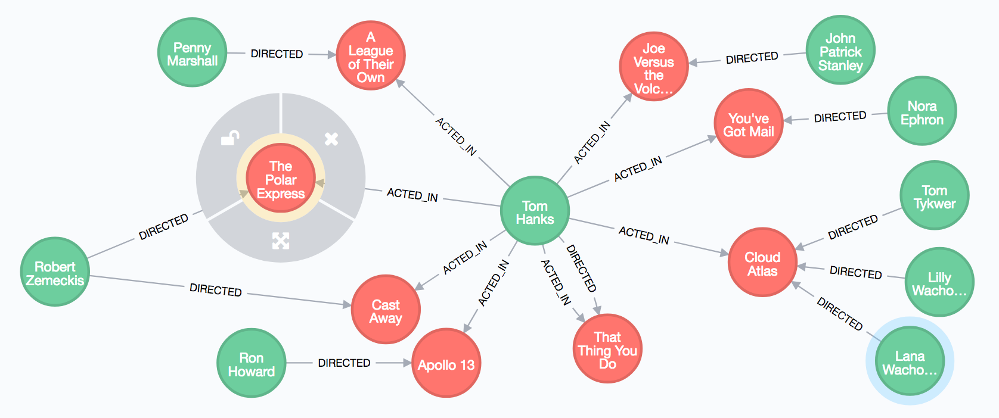
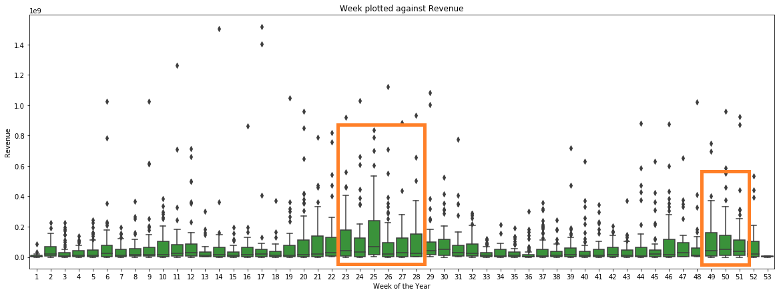
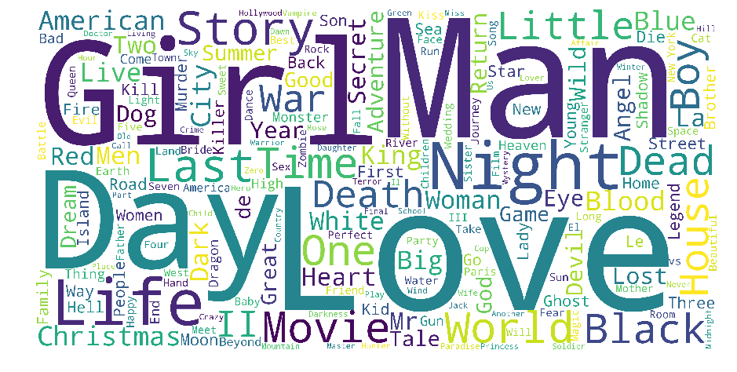
We are research oriented
The word Love is the most used word in movie titles. Girl, Day and Man are also among the most commonly occurring words.
01
Trending keywords, genres
Minions is the most popular movie by the TMDB Popularity Score. Wonder Woman and Beauty and the Beast, two extremely successful woman centric movies come in second and third respectively
02
Popular Movies, Actors, Directors
03
Uncover relationship among a different combination of actors, directors and producers to find out what works best.
Uncover hidden relationships
04
Feature Engineering
Create new features that positively impact the model performance and predictions
Notes:
Our second biggest strength, we devote a lot of time to research. We churn out the data to get new insights that we then pass on to our clients.
This way we keep our clients updated with what’s “trending” in the Industry be it the catchy keywords, cool genres or soul sucking tagline, you name it!!
But we don’t stop there. We help them uncover hidden relationship among different combination of actors, directors and producers using intuitive visualization to figure out what works best for our clinets.
And as mentioned earlier, we engineer new features out of the existing one. For example, we are now taking inflation adjusted budget and seasonality into account as our research shows that some seasons generate more revenue than others.

Slide 9
AdaBoost
LightGBM
XGBoost
RMSLE: 1.64
MAE: 81,299,105.58
RMSLE: 1.21
MAE: 81,299,105.58
RMSLE: 1.14
MAE: 35,945,307.01
Ensemble Methods
Baseline: 16,959,045,463.58
Demo
Notes:
As for the models, we are currently using three different variations of Ensemble Models which are a collection of multiple models combined to produce improved results. All of these perform way better than the simple regression model. And within the ensemble methods we consider XGBoost to be a bit more superior as compared to the other ones because of the lowest Root Mean Squared Error.

Slide 10






A SOLUTION FOR YOUR ENTIRE TEAM
$899
$1,900
$3,900
Model: LGBoost
Error Margin: 23%
24 hour turn around
Model: XGBoost
Error Margin: 20%
24 hour turn around
Customized parameters
Model: Stacked
Error Margin: 17%
24 hour turn around
Dedicated Team
As used by
Notes:
And now if you’re convinced about the potential of our application, we have a special offer for you. We are giving you a free trial for the first month, and from next month onwards you can choose among what suits you best.
As a concluding statement I would like to say Believe me Sahu, if you do even half as well as the rest of clients in this fund, you’re going to be very, very impressed. Sound fair enough?

Slide 11
Why Gradient Boosting?
It is powerful enough to find any nonlinear relationship between your model target and features and has great usability that can deal with missing values, outliers, and high cardinality categorical values on your features without any special treatment.
Parameters used in Gradient Boosting:

Slide 12
What other models we tried?
LGB:
AdaBoost:
CatBoost:

Slide 13
Why RMSE?

